Slide 1
Fine-tune SLM w/ LORA
HasGeek
The Fifth Elephant
Mayur Madnani

Slide 2
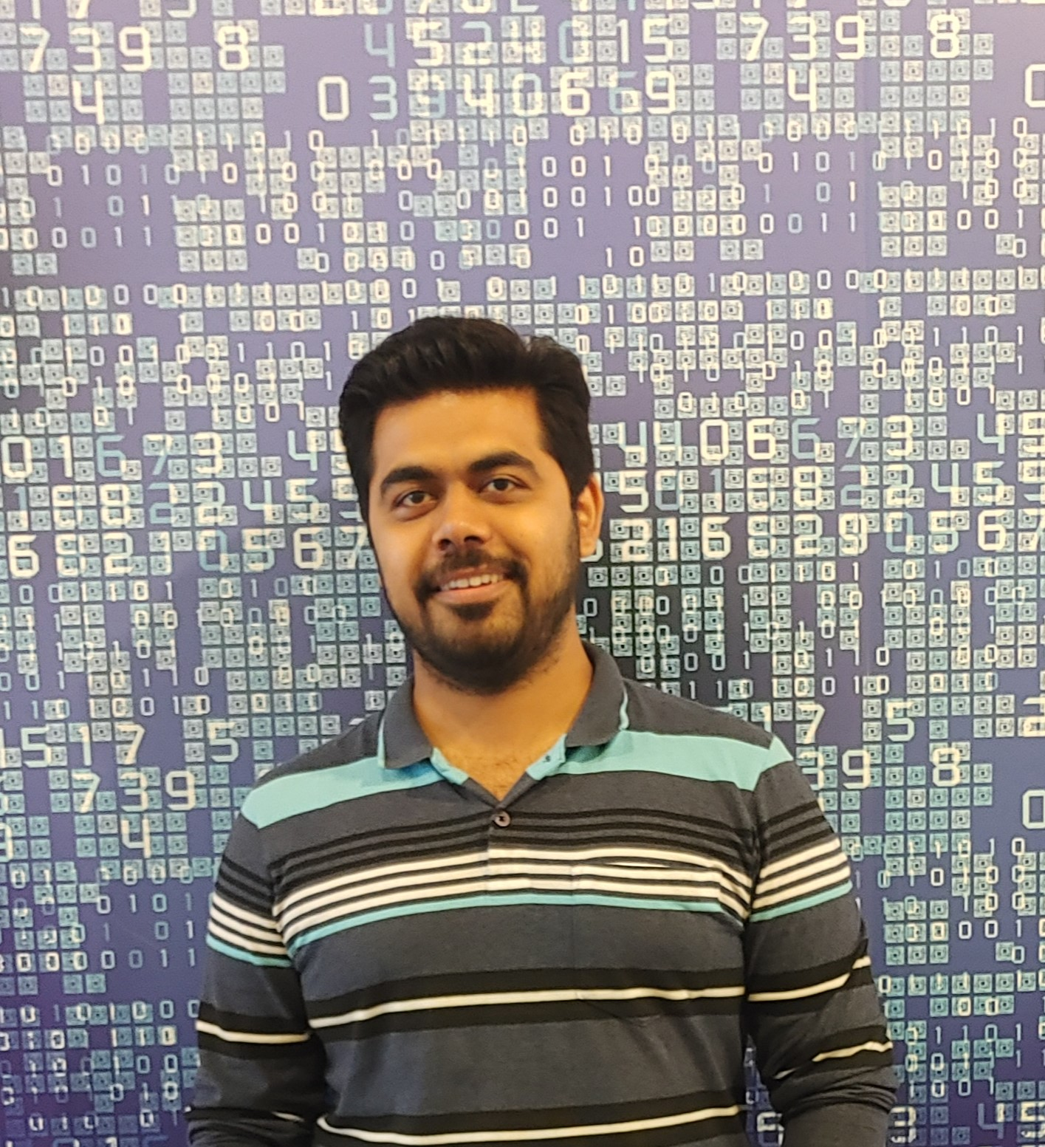
Who Am I?
Staff Engg @ JioHotstar
Previously @ Intuit, Walmart, SAP
Expertise in Data, AI and Backend
~10 years in the Industry
GenAI Course Author
Speaker & Mentor
Mayur Madnani

Slide 3
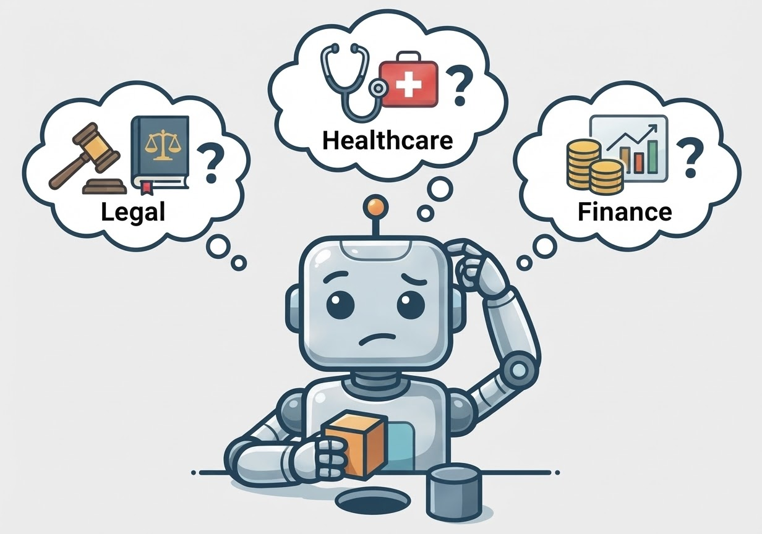
The “Generalist” Problem

Slide 4
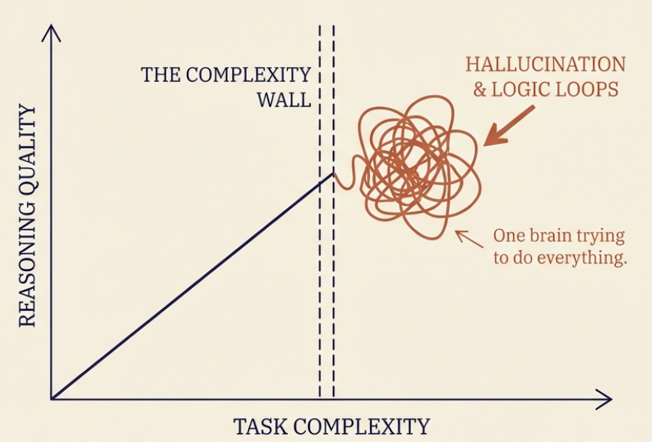
The “Generalist” Problem

Slide 5
The “Generalist” Problem
Domain Mismatch
Struggle in specialized fields
Static Knowledge
Real time information & context
Deployment Constraints
Cost and Practicality

Slide 6
LLMs / SLMs
Large Language Models (LLMs)
Small Language Models (SLMs)
Massive Scale
Knowledge Transfer
Deep Architecture
Compact Architecture
Versatile
Precision focused
Resource Intensive
Agentic & privacy focus
Performance
Domain specialist

Slide 7
LLMs / SLMs
Feature | LLM | SLM
Philosophy | One model to rule them all | Right tool for the right job
Scale | Massive parameters (100B+) | Compact & Efficient (<10B)
Focus | General purpose versatility | Domain precision & Agentic workflows
Resources | Requires data center clusters | Runs on consumer GPUs/edge devices
Outcome | Raw Knowledge Capability | Privacy, Speed, and ROI

Slide 8
Model Adaptation
Technique | Use Cases | Cost
Prompt Engineering | Guided reasoning without training
Parametric (Full) | Complete retraining
Semi-Parametric | Injecting live facts/documents
Parametric (Efficient) | Updating specific skills

Slide 9
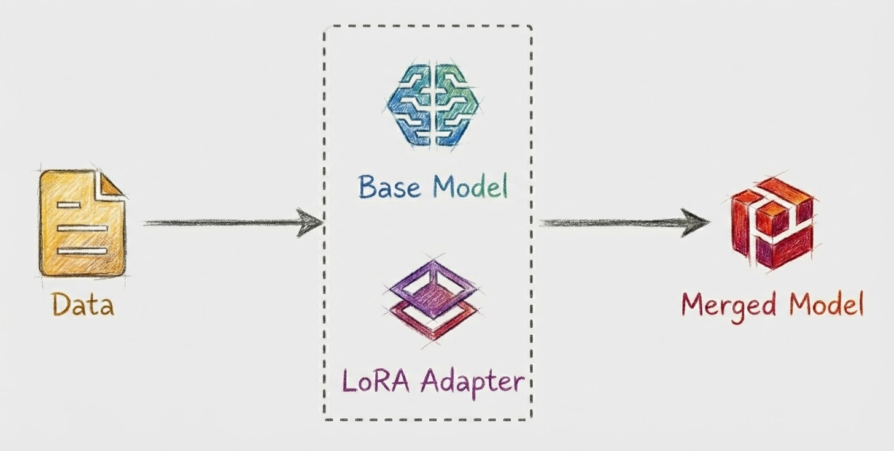
Low-Rank Adaptation (LoRA)

Slide 10
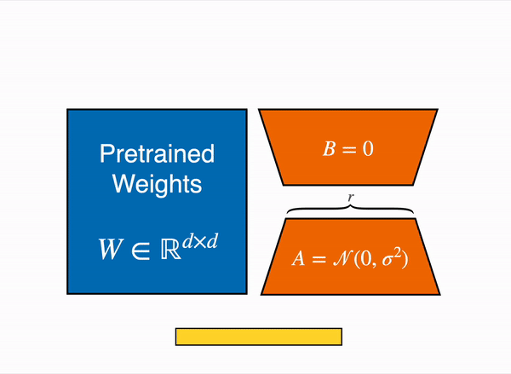
Low-Rank Adaptation (LoRA)

Slide 11
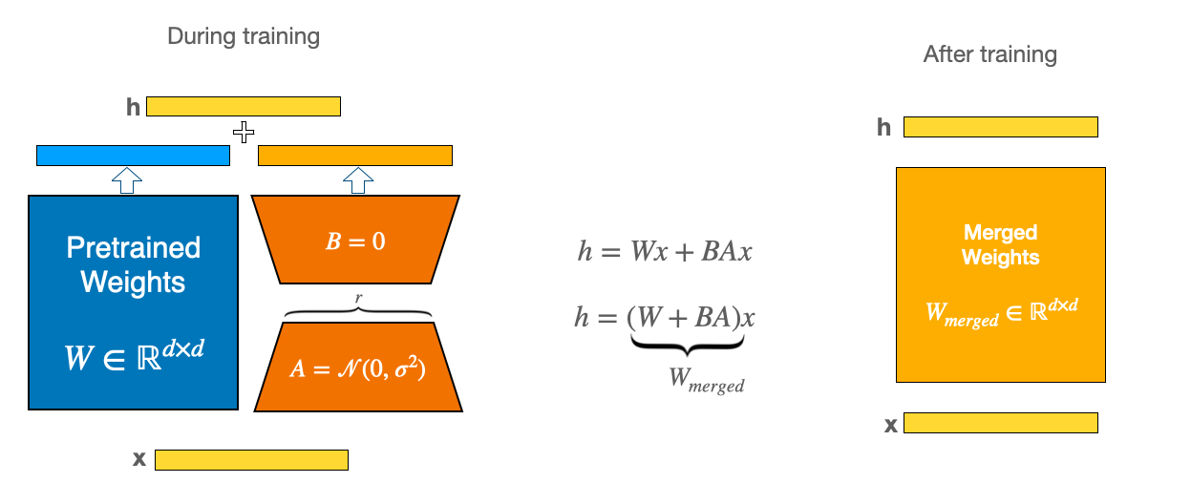
Low-Rank Adaptation (LoRA)

Slide 12
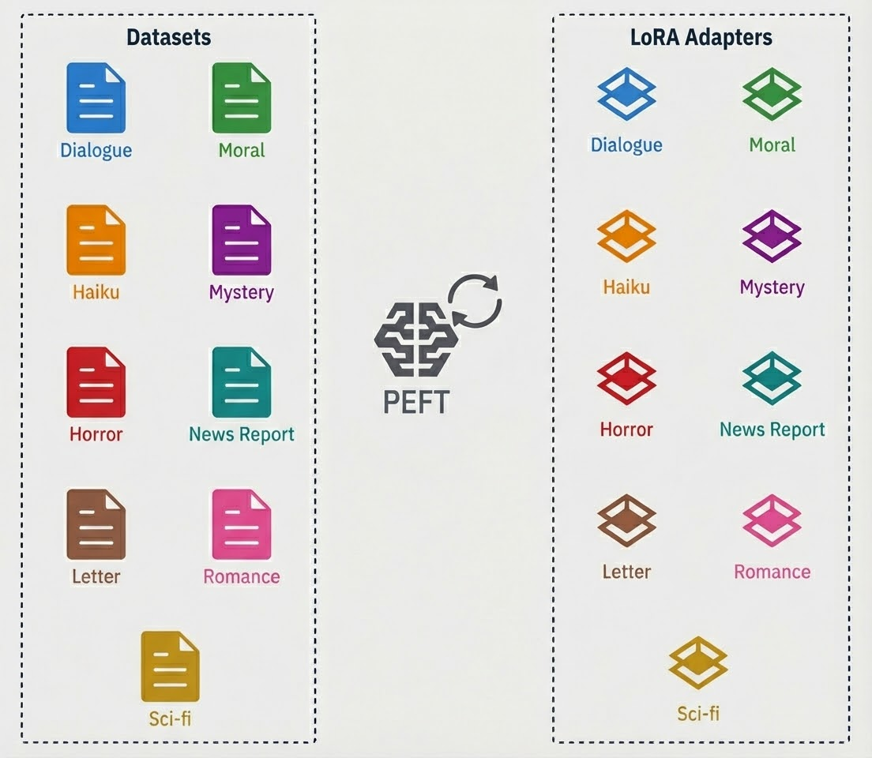
LoRA Adapters

Slide 13




Key Takeaways
1
Shift from Giants to Specialists
2
Scaling down for practical utility
3
Adaptation- Jack of all trades into a Master of One
4
The Modular Ecosystem

Slide 14
WORKSHOP
TIME

Slide 15

Workshop
https://github.com/mayurmadnani/MicroFables

Slide 16

Thank You!!
https://linkedin.com/in/mayurmadnani

